Slide 1
Living area dimensions and rent prices in Moscow
By Sarah Pedigo

Slide 2
Problem and hypothesis
Problem: “How do living area dimensions affect rent prices in Moscow?”
Hypothesis: I hypothesize that the living area dimensions account for 20% or less of the variation in rent prices. I will test this using a metric called the r2 score.

Slide 3
Data analysis process:
Data exploration, cleaning, and preparation
Model creation
Model prediction
Model analysis

Slide 4
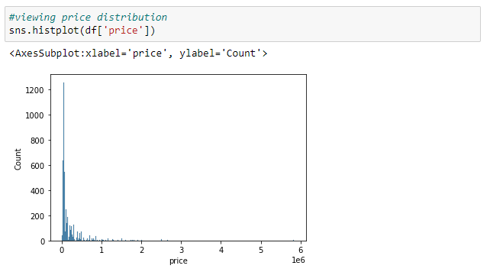
Data exploration step one: viewing distribution of price
I will begin by viewing the distribution of price.
*There are a few prices that are much higher than others, seen as really short bars on the graph. These will be removed for analysis so they don’t skew the results.

Slide 5
Cleaning step one: removing outliers
Here we are removing any rows that have a price of 100,000 Rubles or more.
This will help prevent a few exceptions from altering the summary of what is normal or average.

Slide 6
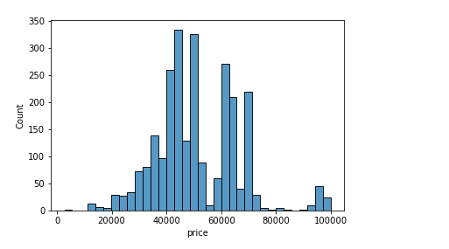
Data exploration step two: updated visualization of price
This is the updated chart after removing prices of 100,000 Rubles or more. Most fall between 40,000 and 60,000.

Slide 7
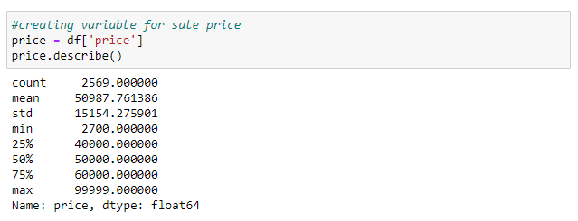
Data exploration step three: looking at price in detail
Summary:
Average price: 50,987 Rubles, equal to approximately $514 U.S. Dollars
Lowest price: 2,700 Rubles, equal to approximately $31 U.S. Dollars
Highest price: 99,999 Rubles*, equal to approximately $1140 U.S. Dollars
*There were a few apartments above this prior to filtering. This is the maximum for the dataset we are working with.

Slide 8
Data preparation steps
Change data types
Change data shape
Split the data into training and testing groups. We will train the model on 80% of the data and then test it on the 20% to see how accurate it is.

Slide 9
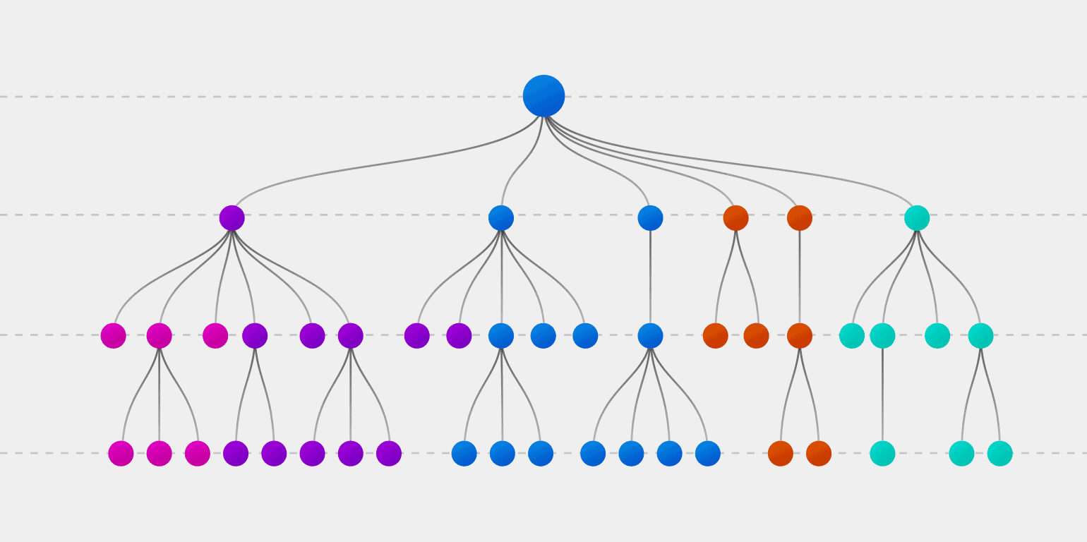
About the model
The model I selected is called a Decision Tree. It divides the data into many sub-groups, each representing a feature. It uses these groups to calculate the probability of each value and use that to make predictions.

Slide 10

Model creation step one
Next step: Model prediction
We create the model by simply calling it and telling it to use our training data.
After creating the model, we use it to make predictions. The living area dimensions from the testing group are the inputs. The model then predicts the prices as outputs.

Slide 11
Model analysis step one: Calculating score
Next, we compare the predictions and the group of testing data we left out.
The measurement I used was the r2 score.
It tells us what percent of the variation in price is accounted for by living area dimensions alone.

Slide 12

Model analysis step two: Interpreting the score
The r2 score for the model is 0.14.
We can interpret this as 14% of the variation in price is due to living area dimension, and 86% is not.

Slide 13
Conclusion
Stated hypothesis: Less than 20% of the variation in price is due to living area dimensions
Result = 14%
14 is less than 20, so I fail to reject my hypothesis.

Slide 14
Limitations of tools and techniques
Very small dataset when compared to the number of properties available for rent at this time.
Only one type of model was created. Others may be more accurate.

Slide 15
Expected benefits of the study
Established average rent of 50,987 Rubles with a mid range of 40,000 to 60,000 Rubles
Established 14% of rent variation is due to living area.
These numbers serve as reference for those looking for rental properties in Moscow right now.

Slide 16
Suggested actions and further studies
Running a full analysis with all given variables
Tracking prices for each property over time
Gathering more data from around the internet

Slide 17
Sources
Efimpolianskii. (2022, March 22). 🏠 real estate rent in Moscow [weekly versioned]. Kaggle. Retrieved March 31, 2022, from https://www.kaggle.com/timmofeyy/realestaterent

